Slide 1

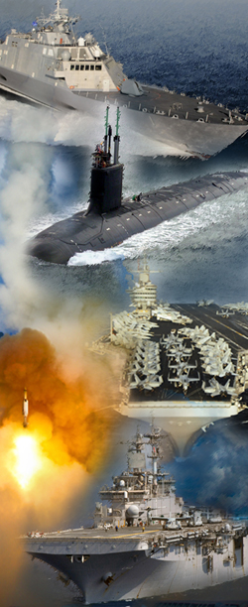
Small Business Innovation Research (SBIR) Small Business Technology Transfer (STTR)
Jason Schroepfer
NAVSEA SBIR/STTR Program Manager
jason.b.schroepfer.civ@us.navy.mil
DISTRIBUTION STATEMENT A. Approved for public release; distribution unlimited
1

Slide 2

What is SBIR/STTR?
Small Business Innovation Research (SBIR) – Established in 1982
Funds Research & Development (R&D) at small businesses (≤ 500 employees)
Increases small business participation in federally funded research and development
Stimulates technological innovation and increases private sector commercialization of federal R&D
Small Business Technology Transfer (STTR) – Established in 1992
Funds cooperative R&D between small businesses and research institutions
Creates vehicles for moving ideas from research institutions to market
Enables researchers to pursue commercial application of technologies
Navy SBIR/STTR
8 organizations (NAVSEA, NAVAIR, ONR, SSP, NAVWAR, MARCOR, NAVFAC, and NAVSUP) actively participate
NAVSEA has 6 SBIR/STTR Teams with extramural R&D budgets that require participation
  PEO IWS, Team SHIPS, PEO USC, PEO CV, Team SUBS, NAVSEA HQ & DIRECTORATES
Produces better, faster, cheaper products and processes for Navy use
Addresses Department of Navy needs by commercializing innovative R&D
NAVSEA SBIR/STTR
NAVSEA awarded the following amounts in FY 2018 through FY 2022:
FY 2018-22 | Phase 1 | Phase 2 | Phase 3
Amount | $109M | $504M | $2.4B
# of Businesses | 311 | 203 | 67
DISTRIBUTION STATEMENT A. Approved for public release; distribution unlimited
2

Slide 3
SBIR/STTR Program Goals
SBIR Program goals:
  Stimulate technological innovation
  Foster participation by socially and economically disadvantaged firms in technological innovation
  Increase small business participation in federally funded Research and Development
  Increase private sector commercialization of federal R&D
STTR Program goals:
Create vehicles for moving ideas from research institutions to market
Enable researchers to pursue commercial application of technologies
Bridge funding gap between basic research and commercial product
DISTRIBUTION STATEMENT A. Approved for public release; distribution unlimited
3

Slide 4



SBIR/STTR – Three Phase Program
Year 1
Year 2
Year 3-5
Year 6-8
Year 8+
Prototype Testing & Evaluation
Technology Demonstration & Validation
Topic
Development*/
BAA Process
Concept Dev. & Feasibility Demo
Technology Development/
Prototype Experimentation
Phase I:
Concept Development &
Feasibility Study
Phase II:
Full Research,
R&D to Prototype
Phase III:
Commercialization
$240K Contract (SBIR/STTR Funds)
  $140K base - 6 months
  $100K option - 6 months
$2M Contract (SBIR/STTR Funds)
  $700K base – 12 months
  $650K option – 12 months
  $650K option – 12 months
Commercialization Readiness Prog.
SBIR/STTR Transition Program (STP)
No Funding Caps (Non-SBIR/STTR $)
  No limit on number of awards
  Can be sole-sourced
Managed & Funded by the NAVSEA - SBIR/STTR Program Office
SBA adjusts cost ceilings each year for inflation
Selected, Funded, and Awarded by Navy PMOs & Contracting Orgs
SBIR / STTR Buys Research and Development, Not Parts and Services
DISTRIBUTION STATEMENT A. Approved for public release; distribution unlimited
4

Slide 5
Eligibility Requirements
A Small Business Concern (SBC) must satisfy the following conditions on the date of award for both Phase I and Phase II funding agreements:
Is organized for profit, with a place of business located in the United States, which operates primarily within the United States or which makes a significant contribution to the United States economy through payment of taxes or use of American products, materials or labor;
Is in the legal form of an individual proprietorship, partnership, limited liability company, corporation, joint venture, association, trust or cooperative, except that if the concern is a joint venture, each entity to the venture must meet the requirements set forth in paragraph (3) below;
Is more than 50 percent directly owned and controlled by one or more individuals (who are citizens or permanent resident aliens of the United States), other small business concerns (each of which is more than 50% directly owned and controlled by individuals who are citizens or permanent resident aliens of the United States), or any combination of these;
Has, including its affiliates, not more than 500 employees.
DISTRIBUTION STATEMENT A. Approved for public release; distribution unlimited
5

Slide 6
Other Rules
SBIR:
A minimum of 2/3 of the research and/or analytical effort must be performed by the proposing firm for Phase I.
A minimum of 1/2 of the research and/or analytical effort must be performed by the proposing firm for Phase II.
STTR:
The proposing firm must subcontract a portion of the award to a research institution that is owned and operated exclusively for scientific or educational purposes, non-profit, and located in the US. Research institutions eligible to participate in the STTR Program include:
  Nonprofit college or university
  Domestic nonprofit scientific/research organization
  Federally Funded R&D Centers (FFRDC)
A minimum of 40% of the research and/or analytical effort must be performed by the Small Business.
A minimum of 30% of the research and/or analytical effort must be performed by the Research Institution.
DISTRIBUTION STATEMENT A. Approved for public release; distribution unlimited
6

Slide 7
Traditional Solicitation Schedule
Broad Agency Announcements (BAAs) are released 4 times a year
A DoD Agency-wide announcement includes:
  DoD Instructions
  Service/Component Unique Instructions
  SBIR/STTR Topics
Not all Components participate in each solicitation
Multiple solicitations provide opportunities to participate throughout the fiscal year
FY
24 OPEN
FY
24.1/A
FY
24.2/B
Pre-Release
11/29/23
Open
01/03/24
Close
02/07/24
Pre-Release
04/17/24
Open
05/15/24
Close
06/12/24
Pre-Release
06/??/24
Open
07/??/24
Close
08/??/24
NAVSEA typically participates in FY XX.1/A
(Contains the largest number of topics)
Occasional and limited participation in
FY XX.2/B, FY XX.3/C, and ad hoc calls if funding permits
*Dates subject to change*
DISTRIBUTION STATEMENT A. Approved for public release; distribution unlimited
7

Slide 8
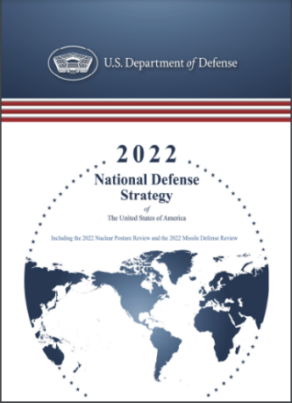
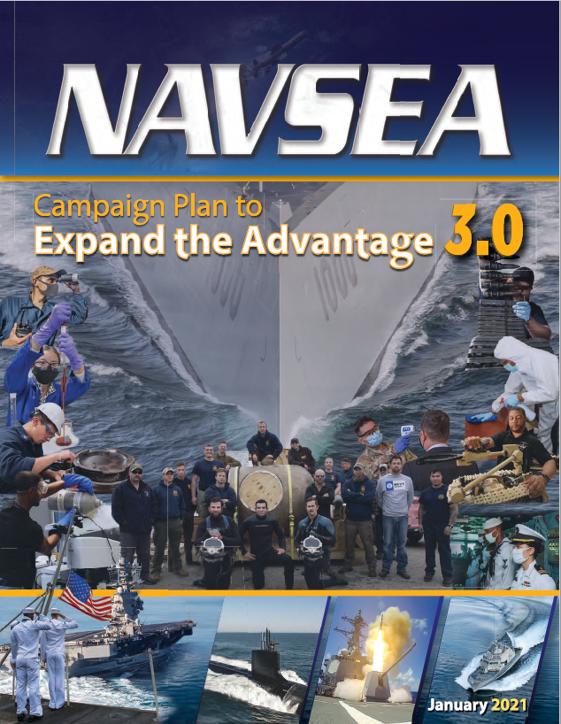
Mission Priorities / Planning for Success
Defend the homeland
Deter strategic attacks against the US, Allies, and partners
Deter aggression while being prepared to prevail in conflict
Build a resilient Joint Force and defense ecosystem
  Transform the Foundation of the Future Force
  Make the Right Technology Investments
  Adapt and Fortify Our Defense Ecosystem
  Strengthen Resilience and Adaptability
  Cultivate the Workforce We Need
Deliver Combat Power: On-Time Delivery of Combat-Ready Ships, Submarines, and Systems
  Maintenance/Sustainment/Readiness, and Modernization
Transform Digital Capability
  Digital Engineering, AI/ML, Additive Manufacturing, and Cybersecurity
Build a Team to Compete and Win
  Partnerships with industry, academia, and other government organizations
Transition Target Participation:
Planned
Builds topic timeline into acquisition schedule
Size, Weight, Power (SWaP) and Cost savings
Form, Fit, and Function Requirements
Endorsed
Participates in development of each topic
Funded
POMs for Phase III RDT&E or Procurement funds early in the process
DISTRIBUTION STATEMENT A. Approved for public release; distribution unlimited
8

Slide 9
Phase II Reachback
After 2013, Phase II awards were limited to two per topic per company
SBIR/STTR Policy directive states there is no time limit between SBIR contract awards
“Reaches back” to an older topic that has not yet accrued $2M in SBIR funding
  If project has accrued $2M in SBIR funding, the request must be submitted as a CRP project
  Topic must be seeking innovation and R&D; cannot be used as a means of procurement
  Reachback requires a strategy to transition technology to the warfighter
As long as work is within the scope of the topic, we can award a Phase II. For example:
  Company won a Phase I in 2015 for $150k
  Phase I completed but no funding was available for Phase II in 2016
  In 2023 a need arose where the work done in Phase I was applicable
  A Phase II was requested for $2M
  In parallel, paperwork for a Phase III contract was started for $25M
Previous Navy SBIR/STTR projects can be found in the “Search Awards Database” at navysbir.com.
DISTRIBUTION STATEMENT A. Approved for public release; distribution unlimited
9
Notes:
Slide 9 Reachback
As PM I always had risk in my programs. I rarely had enough funding to reduce that risk within the program funds. So I used to write topics in hopes I guessed correctly. Well in some cases I did but usually out of synch when I needed the work done. But I did learn to look at older topics winners and meet some very smart people. I also looked at other people’s topics.
So when a risk came to the point where I needed some work done, I would first look at older topics and see if what I needed was related to the work already accomplished – iaw SBIR Policy directive if it was a “…logical extension derivation or conclusion to the product or process worked on under prior SBIR contracts”.
If you read the documents I noted earlier you will see that the rules do not always tell you what you can do. For instance there is no time limit between Phase 1 and Phase2 and Phase3. A Phase 1 winner in 2005 is always a winner – if they went to Phase 2 or not. Ditto for a Phase 2 winner who never went to Phase 3.
So when you open your eyes, you realize you have access to every SBIR Phase 1 winner awarded since 1982! It is quite a discovery. Just think at NAVSEA alone we averaged say 25 topics a year for 30 years = 750 Topics and on average we awarded 2 winners per topic – I have 1500 winners to choose from! But because I can draw from any navy or any DOD topic Think 10s of thousands and now we can pull from any agency …..think of even more!

Slide 10


Commercialization Readiness Program (CRP) – Phase II.5
Requires the program office to provide one-to-one matching (non-SBIR funds) once the project has reached the $2M SBIR funding threshold
  CRP requires a strategy to transition technology to the warfighter
  Topic must be seeking innovation and R&D; cannot be used as a means of procurement
The purpose of a CRP project is to:
  Provide additional funding for SBIR/STTR technologies, products, and services that have potential for rapid transition to Phase III and into the acquisition process
  Accelerate the transition of technologies, products, and services developed under the SBIR/STTR Programs
With the matching funds requirement, a company can receive up to $4M ($2M SBIR and $2M Non-SBIR) to assist projects with strong transition potential
  Contract value can be higher but SBIR/STTR $ stops here
  Matching funds must be placed on the associated Phase II contract
=
DISTRIBUTION STATEMENT A. Approved for public release; distribution unlimited
10
Notes:
Slide 9 Reachback
As PM I always had risk in my programs. I rarely had enough funding to reduce that risk within the program funds. So I used to write topics in hopes I guessed correctly. Well in some cases I did but usually out of synch when I needed the work done. But I did learn to look at older topics winners and meet some very smart people. I also looked at other people’s topics.
So when a risk came to the point where I needed some work done, I would first look at older topics and see if what I needed was related to the work already accomplished – iaw SBIR Policy directive if it was a “…logical extension derivation or conclusion to the product or process worked on under prior SBIR contracts”.
If you read the documents I noted earlier you will see that the rules do not always tell you what you can do. For instance there is no time limit between Phase 1 and Phase2 and Phase3. A Phase 1 winner in 2005 is always a winner – if they went to Phase 2 or not. Ditto for a Phase 2 winner who never went to Phase 3.
So when you open your eyes, you realize you have access to every SBIR Phase 1 winner awarded since 1982! It is quite a discovery. Just think at NAVSEA alone we averaged say 25 topics a year for 30 years = 750 Topics and on average we awarded 2 winners per topic – I have 1500 winners to choose from! But because I can draw from any navy or any DOD topic Think 10s of thousands and now we can pull from any agency …..think of even more!

Slide 11
Phase III Transition Requirements
The Government must award Phase III contracts to SBIR/STTR firms that developed the technology to the greatest extent practicable
  This statute justifies sole source follow-on contracts
  The requirement for competition has been satisfied in Phases I and II
The Government must notify the SBA if it intends to pursue R/R&D, production, services, or any combination thereof of a technology developed under an SBIR/STTR award, with an entity other than the SBIR/STTR awardee
  The SBA can compel Government (DoD) to terminate a contract if that contract should have gone to the SBIR/STTR company
For Phase III SBIR/STTR awards, it is sufficient to state for purposes of a Justification and Approval, if one is deemed required by the agency, that the project is an SBIR/STTR Phase III award that is derived from, extends, or completes efforts made under prior SBIR/STTR Funding Agreements and is authorized pursuant to 15 U.S.C. 638(r)(4). Further justification is not needed.
  There is no limit on the value or number of Phase III contracts
  Phase III funds come from a Program Office (NOT SBIR/STTR “seed funding”)
DISTRIBUTION STATEMENT A. Approved for public release; distribution unlimited
11

Slide 12
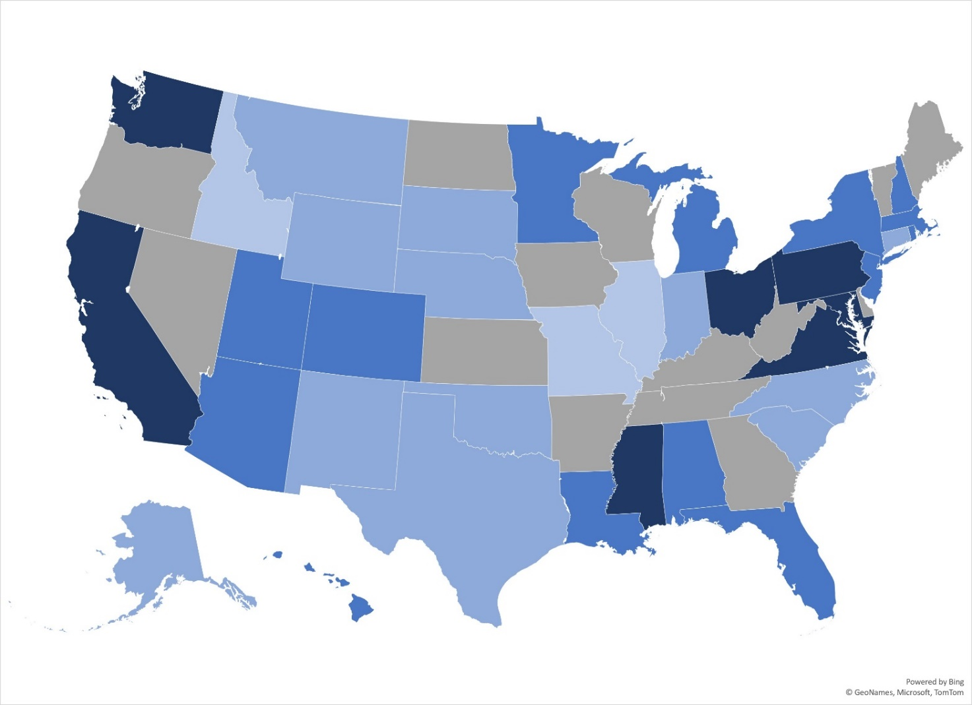
Phase III Transitions by State
No Phase IIIs
<$1M
$1-10M
$10-100M
>$100M
Navy is 50% of DoD Transition (Phase III)
Source: Federal Procurement Data System-Next Generation (FPDS-NG)
+3,400 Funding Actions | +1,000 Contracts | $4B Over 5 Years
DISTRIBUTION STATEMENT A. Approved for public release; distribution unlimited
12
Notes:
Start-ups and small business from across the country have successfully transitioned their technology to the NAVY. All but 13 states (gray shading) have Phase III transition over the past 5 years.

Slide 13
Phase III Transitions by Program
Command/Program Executive Office
Transition ($M)
$2.2B
$963M
Focused topics
align to Programs with resources to transition technology
$349M
$154M
DISTRIBUTION STATEMENT A. Approved for public release; distribution unlimited
13
Notes:
Same Phase III transition data set as the previous Transition by State slide but showing the NAVY Program Offices where the SBIR/STTR-developed technology transitioned.

Slide 14
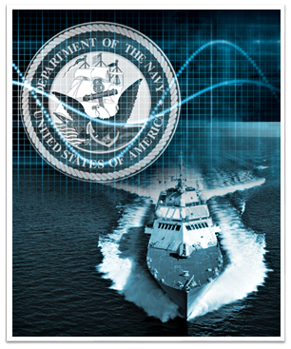
SBIR/STTR Transition Program (STP)
Premier Navy program to foster transition
Small businesses learn how to work with the Navy and identify opportunities to transition their technologies
Small businesses are instructed on the government acquisition environment and policies
Small businesses are provided marketing expertise
The STP program culminates in the Forum for SBIR/STTR Transition (FST)
DISTRIBUTION STATEMENT A. Approved for public release; distribution unlimited
14
Notes:
Here you can see the NAVSEA SBIR Functional Organization with the names of the Technical Managers for each PEO. We report up to ONR with runs the SBIR program for Big Navy as a whole.
14

Slide 15
Forum for SBIR/STTR Transition (FST)
Featured Technologies:
  Advanced Electronics
  Autonomy
  C4I
  Energy & Power Technologies
  Ground & Sea Platforms
  Materials & Manufacturing Processes
  Sensors
  Weapons Technologies
Air Platforms
Biomedical
Electronic Warfare
Engineered Resilient Systems
Human Systems
Modeling & Simulation Technology
Sustainment
48 total projects were showcased at the Navy STP Innovative Technology Showcase at Sea-Air-Space 2023
Project videos at navyfst.com/events/sea-air-space-2023
DISTRIBUTION STATEMENT A. Approved for public release; distribution unlimited
15

Slide 16
Questions?
DISTRIBUTION STATEMENT A. Approved for public release; distribution unlimited
16

